Slide 1
Clustering

Slide 2
Good Initial Centroids
Source of figure: Introduction to Data Mining by Tan et. al.

Slide 3
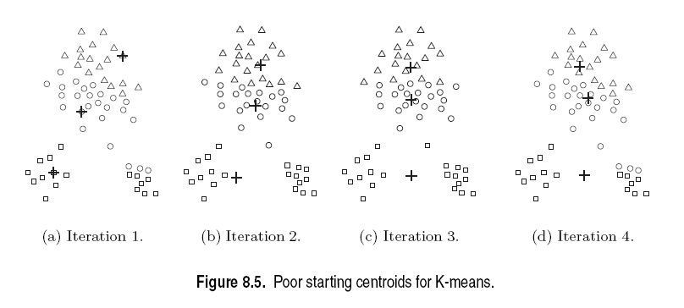
Poor Initial Centroids
Source of figure: Introduction to Data Mining by Tan et. al.

Slide 4
Pros & Cons of K-means
Relatively efficient: O(tknd)
n: # objects, k: # clusters, t: # iterations; n:# attributes k, t << n.
Applicable only when mean is defined
What about categorical data?
Need to specify the number of clusters
Unable to handle noisy data and outliers

Slide 5
Limitations of K-means
K-means has problems when clusters are of differing
Sizes
Densities
Non-globular shapes
Empty clusters
K-means has problems when the data contains outliers.

Slide 6
Choosing Initial Centroids
Random Initialization
Perform multiple runs with randomly chosen initial seeds
Choose the set of clusters with minimum SSE
Not necessarily a good solution
Sampling
Sample and do hierarchical clustering
K clusters are found
Centroids of these clusters are used as initial seeds
Works well only if
Sample is relatively small (few 100_{s} to few 1000_{s})
K<<sample size

Slide 7
Choosing Initial Centroids
Source of figure: Introduction to Data Mining by Tan et. al.

Slide 8
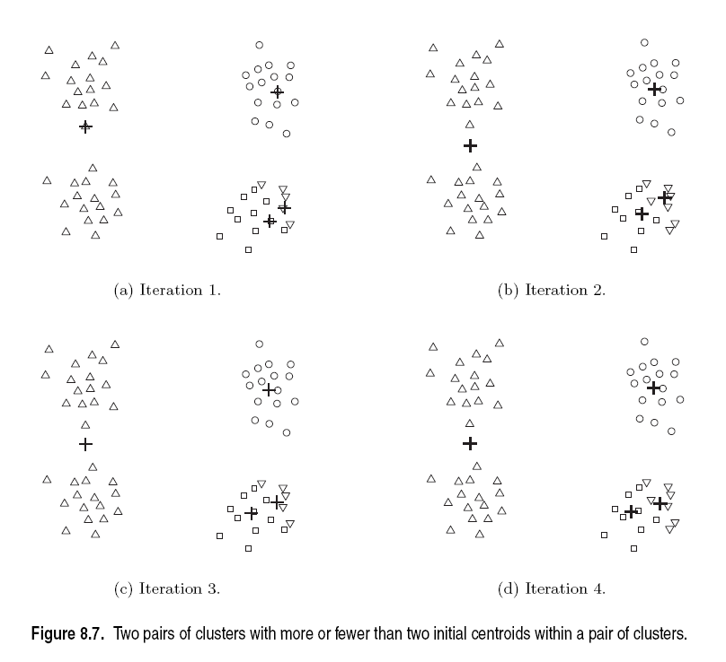
Choosing Initial Centroids
Source of figure: Introduction to Data Mining by Tan et. al.

Slide 9
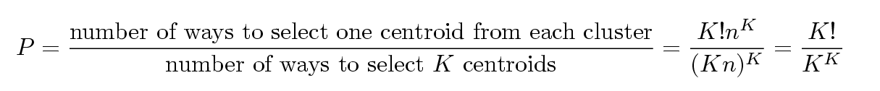
Problems with Selecting Initial Points
If there are K ‘real’ clusters then the chance of selecting one centroid from each cluster is small.
Chance is relatively small when K is large
If clusters are the same size, n, then
For example, if K = 10, then probability = 10!/10¹⁰ = 0.00036
Sometimes the initial centroids will read just themselves in ‘right’ way, and sometimes they don’t
Consider an example of five pairs of clusters

Slide 10
10 Clusters Example
Starting with two initial centroids in one cluster of each pair of clusters

Slide 11
10 Clusters Example
Starting with two initial centroids in one cluster of each pair of clusters

Slide 12
10 Clusters Example
Starting with some pairs of clusters having three initial centroids, while other have only one.

Slide 13
10 Clusters Example
Starting with some pairs of clusters having three initial centroids, while other have only one.

Slide 14
Solutions to Initial Centroids Problem
Multiple runs
Helps, but probability is not on your side
Sample and use hierarchical clustering to determine initial centroids
Select more than k initial centroids and then select among these initial centroids
Select most widely separated
Postprocessing
Bisecting K-means
Not as susceptible to initialization issues

Slide 15
Handling Empty Clusters
Basic K-means algorithm can yield empty clusters
Several strategies
Choose the point that is farthest away from any current centroid
Choose a point from the cluster with the highest SSE
If there are several empty clusters, the above can be repeated several times.

Slide 16
Pre-processing and Post-processing
Pre-processing
Normalize the data
Eliminate outliers
Post-processing
Eliminate small clusters that may represent outliers
Split ‘loose’ clusters, i.e., clusters with relatively high SSE
Merge clusters that are ‘close’ and that have relatively low SSE
Can use these steps during the clustering process

Slide 17
Updating Centers Incrementally
In the basic K-means algorithm, centroids are updated after all points are assigned to a centroid
An alternative is to update the centroids after each assignment (incremental approach)
Each assignment updates zero or two centroids
More expensive
Introduces an order dependency
Never get an empty cluster
Can use “weights” to change the impact

Slide 18
Variations on K-means
Recompute the centroid after every (or few) changes (rather than after all the points are re-assigned)
Improves convergence speed
Starting centroids (seeds) change which local minima we converge to, as well as the rate of convergence
Use heuristics to pick good seeds
Can use another cheap clustering over random sample
Run K-means M times and pick the best clustering that results
Bisecting K-means takes this idea further…
Lowest aggregate
Dissimilarity
(intra-cluster
distance)

Slide 19
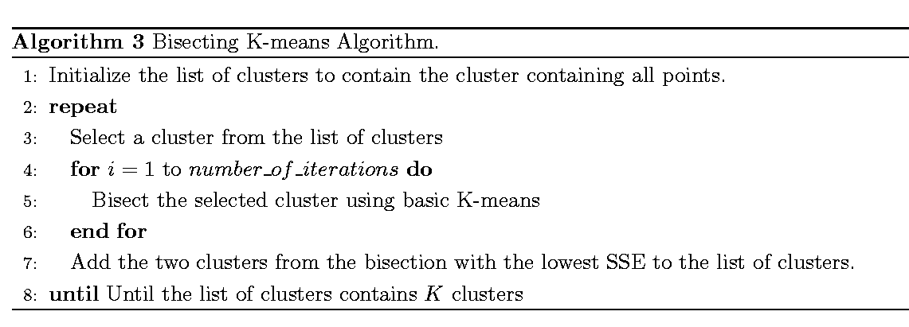
Bisecting K-means
Bisecting K-means algorithm
Variant of K-means that can produce a partitional or a hierarchical clustering

Slide 21
Bisecting K-means
Can pick the largest
Cluster or the cluster
With lowest average
similarity
For I=1 to k-1 do{
Pick a leaf cluster C to split
For J=1 to ITER do{
Use K-means to split C into two sub-clusters, C₁ and C₂
Choose the best of the above splits and make it permanent}
}
Divisive hierarchical clustering method
uses K-means

Slide 22
Limitations of K-means
K-means has problems when clusters are of differing
Sizes
Densities
Non-globular shapes
K-means has problems when the data contains outliers.

Slide 23
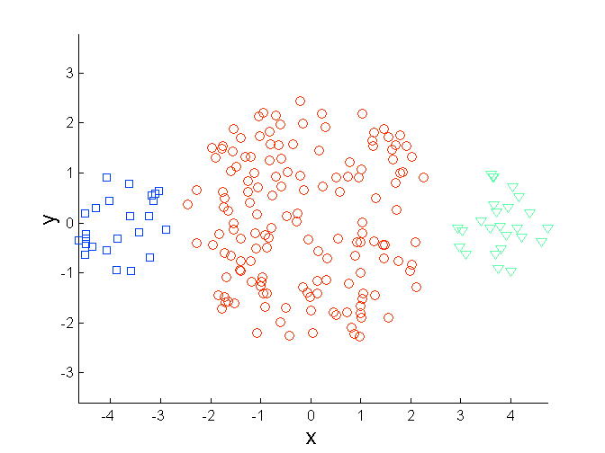
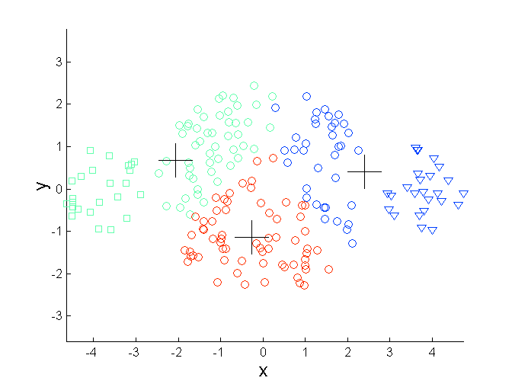
Limitations of K-means: Differing Sizes
Original Points
K-means (3 Clusters)

Slide 24
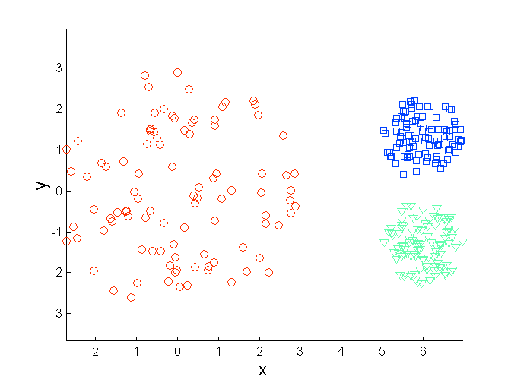
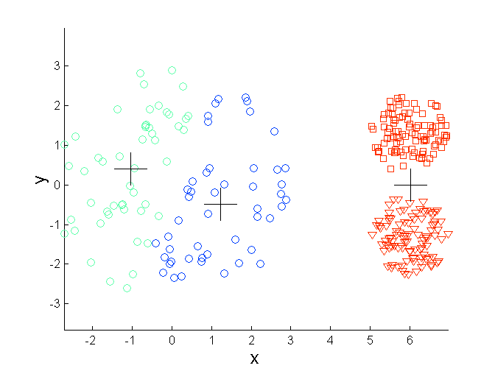
Limitations of K-means: Differing Density
Original Points
K-means (3 Clusters)

Slide 25
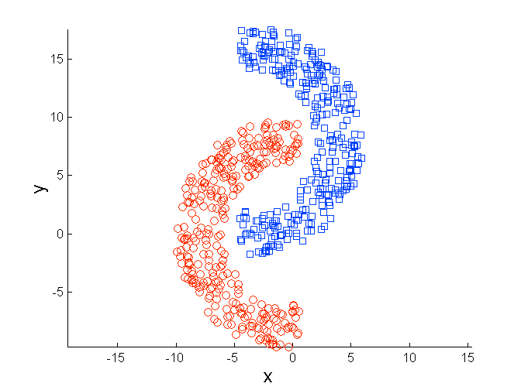
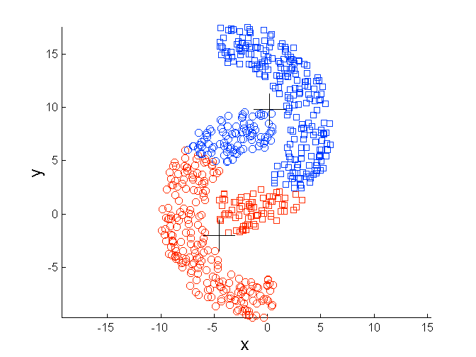
Limitations of K-means: Non-globular Shapes
Original Points
K-means (2 Clusters)

Slide 26
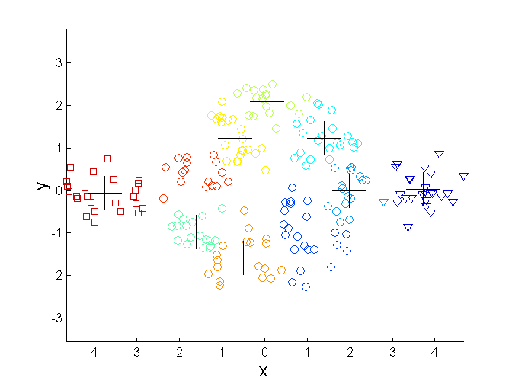
Overcoming K-means Limitations
Original Points K-means Clusters
One solution is to use many clusters.
Find parts of clusters, but need to put together.

Slide 27
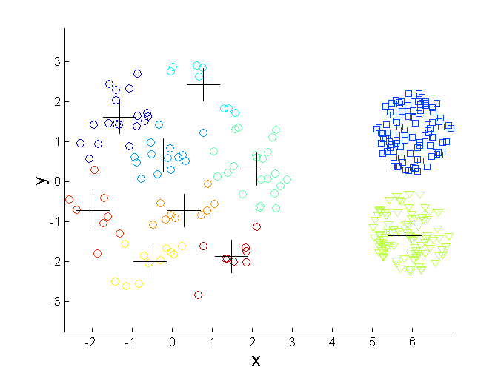
Overcoming K-means Limitations
Original Points K-means Clusters

Slide 28
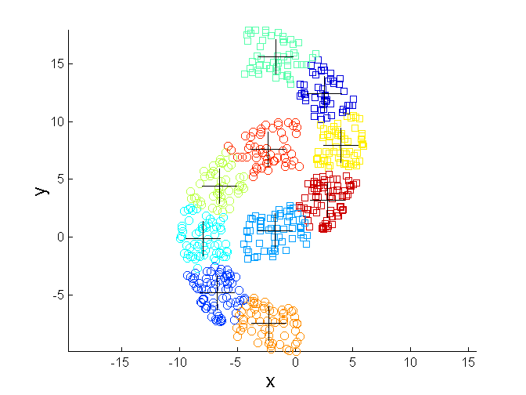
Overcoming K-means Limitations
Original Points K-means Clusters

Slide 29
Types of Clusters
Well-separated clusters
Center-based clusters
Contiguous clusters
Density-based clusters
Property or Conceptual
Described by an Objective Function

Slide 30
Types of Clusters: Well-Separated
Well-Separated Clusters:
A cluster is a set of points such that any point in a cluster is closer (or more similar) to every other point in the cluster than to any point not in the cluster.
3 well-separated clusters

Slide 31
Types of Clusters: Center-Based
Center-based
A cluster is a set of objects such that an object in a cluster is closer (more similar) to the “center” of a cluster, than to the center of any other cluster
The center of a cluster is often a centroid, the average of all the points in the cluster, or a medoid, the most “representative” point of a cluster
4 center-based clusters

Slide 32
Types of Clusters: Contiguity-Based
Contiguous Cluster (Nearest neighbor or Transitive)
A cluster is a set of points such that a point in a cluster is closer (or more similar) to one or more other points in the cluster than to any point not in the cluster.
8 contiguous clusters

Slide 33
Types of Clusters: Density-Based
Density-based
A cluster is a dense region of points, which is separated by low-density regions, from other regions of high density.
Used when the clusters are irregular or intertwined, and when noise and outliers are present.
6 density-based clusters

Slide 34
Types of Clusters: Conceptual Clusters
Shared Property or Conceptual Clusters
Finds clusters that share some common property or represent a particular concept.
.
2 Overlapping Circles

Slide 35
What Is Good Clustering?
A good clustering method will produce high quality clusters with
high intra-class similarity
low inter-class similarity
The quality of a clustering result depends on both the similarity measure used by the method and its implementation.
The quality of a clustering method is also measured by its ability to discover some or all of the hidden patterns.

Slide 36
Requirements of Clustering in Data Mining
Scalability
Ability to deal with different types of attributes
Discovery of clusters with arbitrary shape
Minimal requirements for domain knowledge to determine input parameters
Able to deal with noise and outliers
Insensitive to order of input records
High dimensionality
Incorporation of user-specified constraints
Interpretability and usability

Slide 37
Outliers
Outliers are objects that do not belong to any cluster or form clusters of very small cardinality
In some applications we are interested in discovering outliers, not clusters (outlier analysis)
cluster
outliers

Slide 38
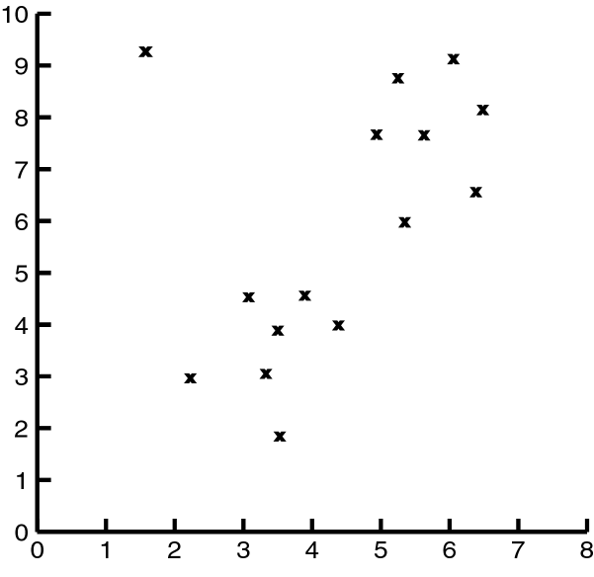
Impact of Outliers on Clustering
Source of figure: Data Mining by Dunham, M H

Slide 39
Problems with Outliers
Many clustering algorithms take as input the number of clusters
Some clustering algorithms find and eliminate outliers
Statistical techniques to detect outliers
Discordancy Test
Not very realistic for real life data

Slide 40
Clustering Problem
Given a database D={t₁,t₂,…,t_{n}} of tuples and an integer value k, the Clustering Problem is to define a mapping f:Dg{1,..,k} where each t_{i} is assigned to one cluster K_{j}, 1<=j<=k.
A Cluster, K_{j}, contains precisely those tuples mapped to it.
Unlike classification problem, clusters are not known a priori.

Slide 41
Clustering Algorithms
K-means and its variants
Hierarchical clustering
Density-based clustering

Slide 42
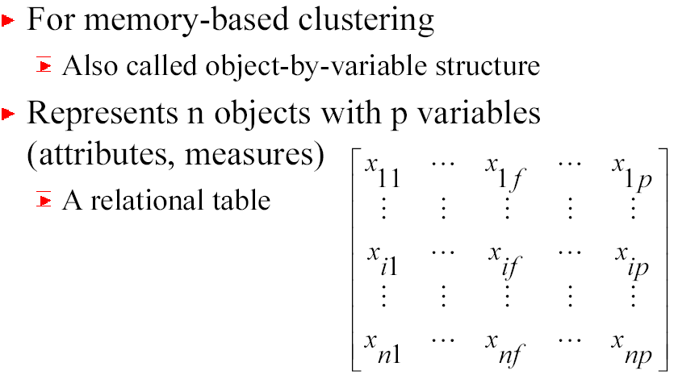
Types of Data in Cluster Analysis
Data matrix

Slide 43
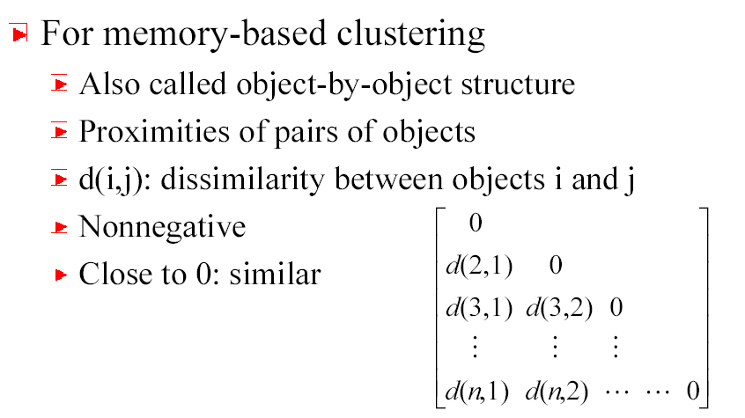
Types of Data in Cluster Analysis
Dissimilarity Matrix

Slide 44
Dissimilarity Matrix
Many clustering algorithms operate on dissimilarity matrix
If data matrix is given, it needs to be transformed into a dissimilarity matrix first
How can we assess dissimilarity d(i,j)?

Slide 45
Types of Data
Interval-scaled variables
Binary variables
Nominal, ordinal, and ratio variables
Variables of mixed types

Slide 46
Interval-scaled Variables
Continuous measurements of a roughly linear scale
Weight, height, latitude and longitude coordinates, temperature, etc.
Effect of measurement units in attributes
Smaller unit Larger variable range Larger effect to the clustering structure
Standardization + background knowledge
Clustering BB player may require giving more weightage to height

Slide 47
Standardizing Variables
Standardize data
Calculate the mean absolute deviation:
where
Calculate the standardized measurement (z-score)
Using mean absolute deviation is more robust than using standard deviation as z-scores of outliers do not become too small and so they remain detectable

Slide 48
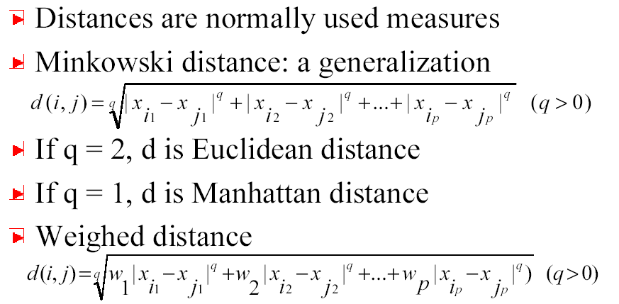
Similarity & dissimilarity between Objects

Slide 49
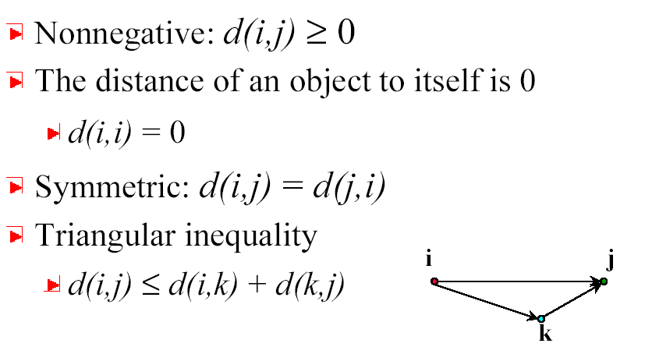
Properties of Minkowski Distance

Slide 50
Binary Variables
A contingency table for binary data
Simple matching coefficient (invariant, if the binary variable is symmetric):
Jaccard coefficient (noninvariant if the binary variable is asymmetric):
Object j
Object i

Slide 51
Dissimilarity between Binary Variables
Example
gender is a symmetric attribute
the remaining attributes are asymmetric binary
let the values Y and P be set to 1, and the value N be set to 0

Slide 52
Nominal Variables
A generalization of the binary variable in that it can take more than 2 states, e.g., red, yellow, blue, green
Method 1: Simple matching
m: # of matches, p: total # of variables
Method 2: use a large number of binary variables
creating a new binary variable for each of the M nominal states

Slide 53
Ordinal Variables
An ordinal variable can be discrete or continuous
order is important, e.g., rank
Can be treated like interval-scaled
replacing x_{if} by their rank
map the range of each variable onto [0, 1] by replacing i-th object in the f-th variable by
compute the dissimilarity using methods for interval-scaled variables

Slide 54
Ratio-Scaled Variables
Ratio-scaled variable: a positive measurement on a nonlinear scale, approximately at exponential scale, such as Ae^{Bt} or Ae^{-Bt}
Methods:
treat them like interval-scaled variables — not a good choice! (why?)
apply logarithmic transformation
y_{if} = log(x_{if})
treat them as continuous ordinal data treat their rank as interval-scaled.

Slide 55
Variables of Mixed Types
A database may contain all the six types of variables
symmetric binary, asymmetric binary, nominal, ordinal, interval and ratio.
One may use a weighted formula to combine their effects.
f is binary or nominal:
d_{ij}^{(f)} = 0 if x_{if} = x_{jf} , or d_{ij}^{(f)} = 1 o.w.
f is interval-based: use the normalized distance
f is ordinal or ratio-scaled
compute ranks r_{if} and
and treat z_{if} as interval-scaled

Slide 56
Similarity Measures
If i = (x_{i1}, x_{i2}, …, x_{ip},) and j = (x_{j1}, x_{j2}, …, x_{jp}) are two p-dimensional data objects, then
Euclidean distance
Manhattan distance
Minkowski distance

